Slide 1
UCD WMH Segmentation
Charles DeCarli
Evan Fletcher
Pauline Maillard

Slide 2
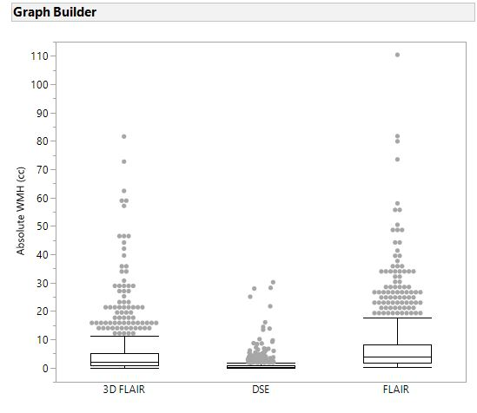
Differences in absolute WMH volumes by Image Type
Note:
DSE =ADNI 1
FLAIR=ADNI Go ADNI 2
3D FLAIR = ADNI 3

Slide 3
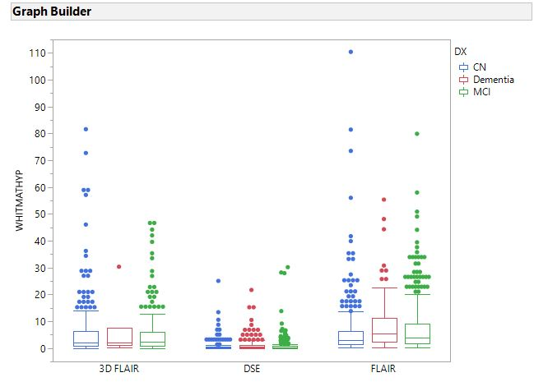
Differences in absolute WMH volumes by Image Type and Dx
Note:
DSE =ADNI 1
FLAIR=ADNI Go ADNI 2
3D FLAIR = ADNI 3

